Slide 1

Please enter your state/province in the Chat plus the year you first attended a Key Leader event.
Welcome—we will be starting in a few moments—please mute your computer.
Notes:
Welcome! Time to do some Q and A about Kiwanis Key Leader.

Slide 2
2022 Volunteer Training
WELCOME!!!
Notes:
Welcome! Time to do some Q and A about Kiwanis Key Leader.

Slide 3

WELCOME TO ALL OUR GREAT VOLUNTEERS!!

Slide 4
Kiwanis Key Leader 2005-2022
Total Student Enrollment from 2005-2021=34,415
693 leadership conferences in 40 US states, 7 Canadian provinces, Brazil, Bahamas, Cayman Islands, El Salvador, Malaysia, Singapore
In 2020= 1 event: New Mexico
In 2021=4 events: Tennessee, New England, Colorado, Indiana
In 2022, Relaunch with 22 events already planned and 10 more in the planning stages

Slide 5
www.key-leader.org
ABOUT: KL Video, Facilitator Bios, Youth Protection, NASSP
FIND EVENTS: Virtual Key Leader, In-Person Event Details
RESOURCES: Event Logistics, Marketing & PR, Guides

Slide 6
COVID-19 and Key Leader
New Guidelines for Event Planning—Things could change almost daily and throughout the continent
Covid Symptom List
Covid Insurance Waiver
All these items are in the Resource Section of the Website

Slide 7
COVID-19 and Key Leader
-Follow all federal and local laws.
-Coordinate with the meeting venue
-Consider requiring all attendees to obtain a negative COVID-19 test or certify that they have been fully vaccinated before the meeting.
-Require all attendees at meetings to sign a waiver that states that anyone who believes they may have contracted COVID-19 at a Kiwanis event waives all related claims against any Kiwanis club, district or Kiwanis International. Any meeting of youth members (younger than 18) in the Kiwanis family will require a signature from a parent or legal guardian. A sample waiver is included here.
-The CDC has stated that individuals who are fully vaccinated do not need to wear masks except in limited circumstances —
-Individuals who are not fully vaccinated should wear masks at Kiwanis events.
-Ask all attendees to certify that they have not experienced any common COVID-19 symptoms in the past 72 hours. A list of common COVID-19 symptoms can be found here.
For Key Leader event teams: Check with your host camp for state/county/camp guidelines for groups. You should periodically check back with the camp to see if anything has changed. Also check with your local school systems to see if they have any regulations on student travel at this time.

Slide 8

Kiwanis Youth Protection Guidelines
Since 2005, Key Leader has been in the forefront of youth protection, before guidelines were even adopted by Kiwanis International Board.
All Key Leader overnight chaperones must be 21 and over as well as having a cleared background check and completion of 3 – 20 minute courses from Praesidium Academy. (Repeat every two years—good for all Kiwanis programs.)
Each event needs to submit a list of their chaperones to backgroundchecks@kiwanis.org at least 4 weeks prior to the event.
If there are questions about this information, contact Melissa at 1-800-Kiwanis Ext 218.

Slide 9
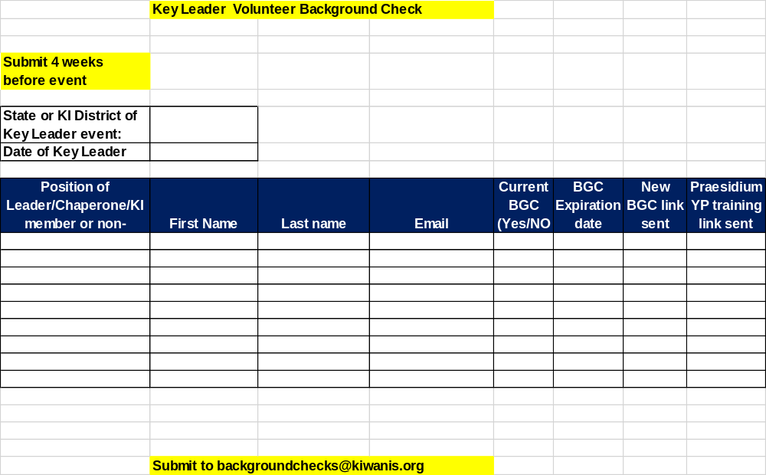
Kiwanis Youth Protection Guidelines

Slide 10

Key Leader Marketing and Logistics Manual
Each Key Leader team needs to refer to this manual for all aspects of the operation. The current manual was updated in April 2019. A new version should be available later this spring. It is best if the document is downloaded for frequent use.
Main information to be found in Manual:
  Job Descriptions for KL District Chair and Site Coordinator (pp.2-3)
  KL Website Information (p.4)
  KL Agreement (pp 6-13) Under Revision at Present
  Youth Protection Guidelines (pp.14-15) updated October 2021
  Marketing (pp. 18-21)
  Risk Management Plan ( pp. 22-23)
  KL “What If” (pp. 23-25) This section should be done with each event team in local training

Slide 11
Key Leader Marketing and Logistics Manual - 2
Information in the manual (continued)
  Lead Facilitator- Role and Responsibility ( p. 27)
  Planning Timetable (p. 28)
  Planning Checklist (pp. 29-32) Local Training
  Adult Expectations (p. 33) Local Training
  Committee/Chaperone Schedule (p. 34) Local Training
  Supplies—Permanent and Students (p. 36)
  T-Shirt—Size Suggestions (p. 36) – Design posted on website
  Snacks (p.37)

Slide 12
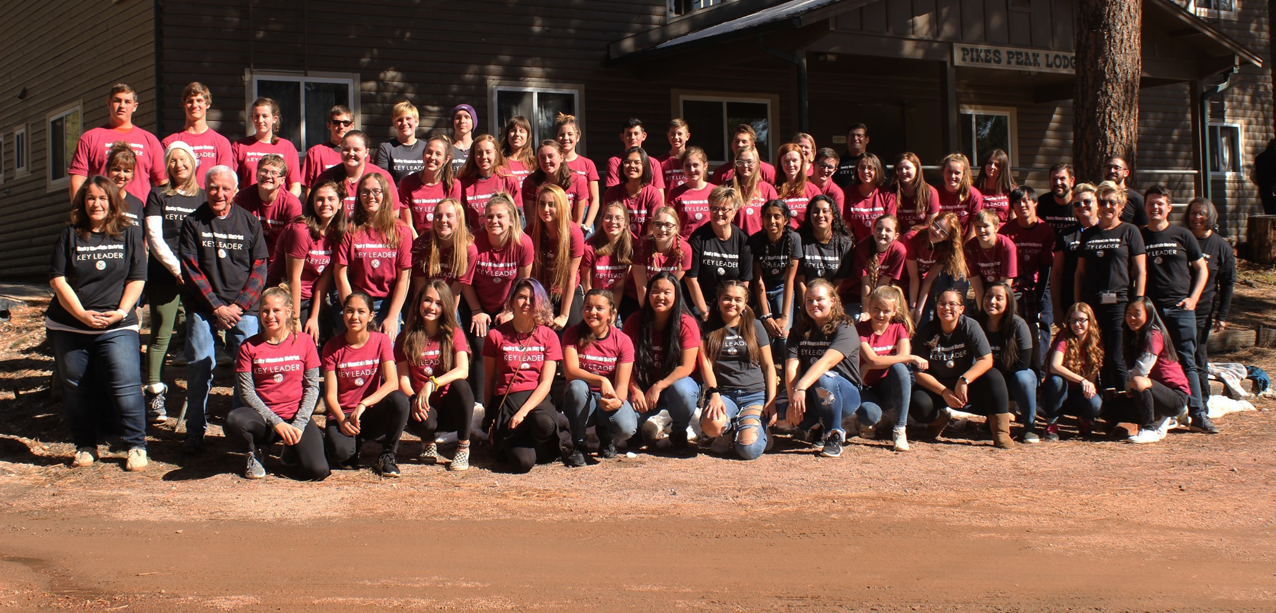
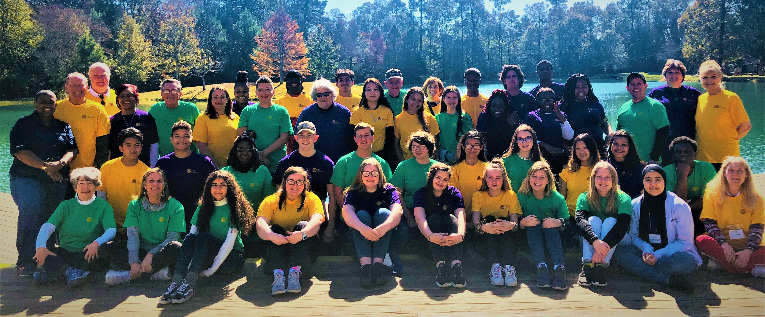
Remember to get a great group picture on Saturday Morning before Lunch—send it to Lisa Pryon at KI (lpyron@kiwanis.org)

Slide 13
MARKETING RESOURCES
Each event should plan a schedule of promotions for Kiwanis mid-winters, Key Club DCONS, and Kiwanis conventions.
Limited supplies of Key Club flyer, adult promo piece and Personality Traits
---Contact KL office in Indianapolis—first come, first served!!
Available for download= flyers for each demographic group (on website)
Each event should customize their own flyer with date, cost, registration link, and contact information.
Work to have information in Kiwanis and Key Club newsletters

Slide 14

Event Marketing Piece
This is a recent example of an Event marketing piece that was prepared by our team in Georgia. Most of these pictures are from their past events.
Way to go team Georgia!!!!

Slide 15
What have we learned?
Teams from TN-NH-CO-IN
Need for new group of Student Facilitators
Approach all promotion to students and most of adults as a brand new “product”
What Else?
Questions….

Slide 16

Thank you for all you will do to bring Key Leader to the world in 2022!!!

