Slide 1

Developing Leaders for Life
Key Leader, what is it all about?
Notes:
Welcome! Time to do some Q and A about Kiwanis Key Leader.

Slide 2
Kiwanis Strategic Plan
Goal:
Kiwanis will be the premier provider
of programs that develop competent, knowledgeable and ethical
youth and adult leaders.

Slide 3
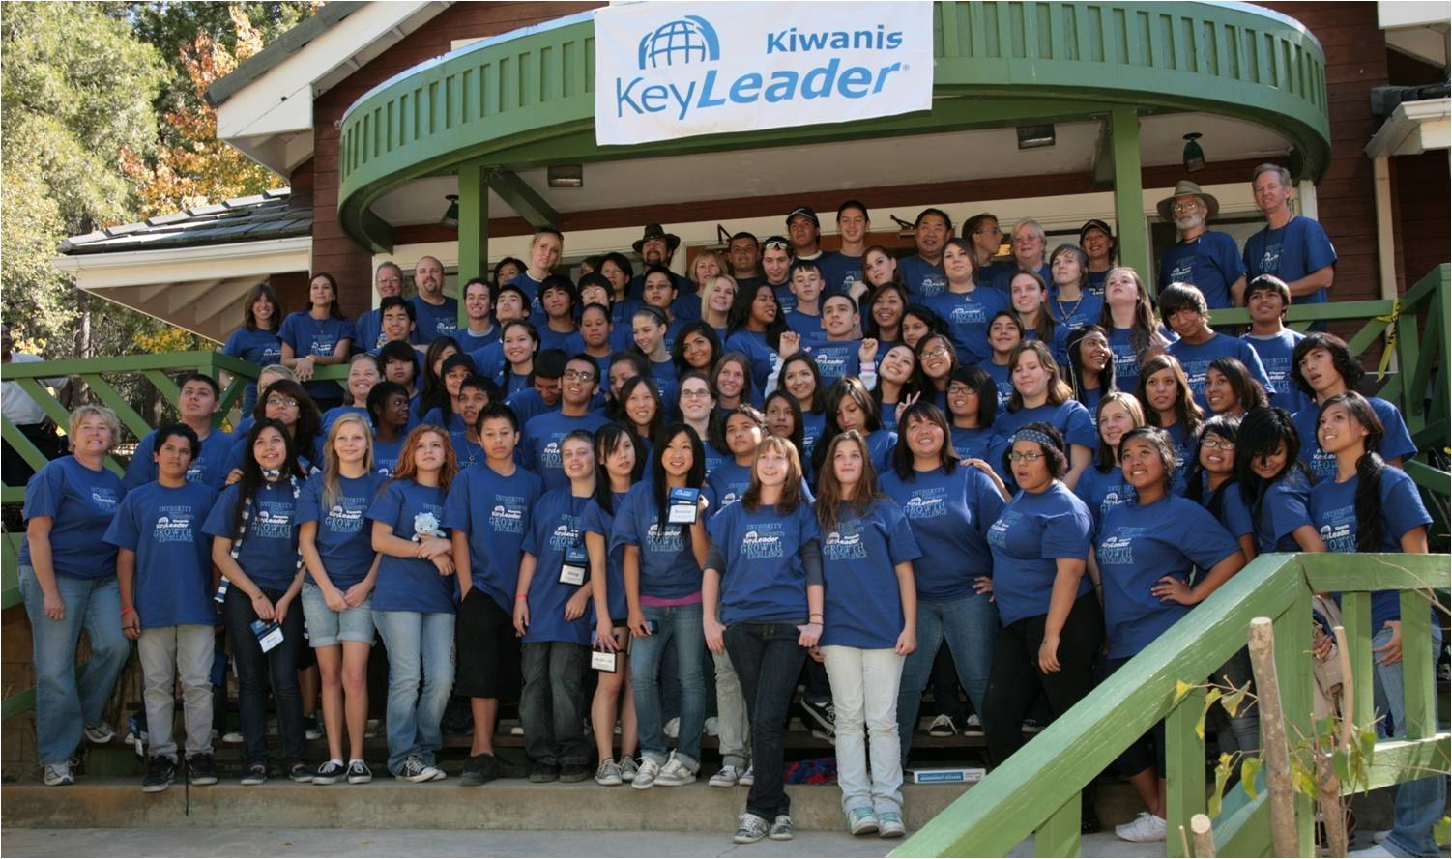
What is Key Leader
A weekend leadership experience for High School students ages 14-18
Offers emerging leaders a taste of what service leadership is all about
Notes:
Key Leader is a weekend service leadership retreat for High School students.
In most cases, events are held at residence camp facilities
Teens are placed into “neighborhoods” for the weekend, which allows for group work and discussion during break out sessions
Service Leadership is one of the foundations of Kiwanis, from K-Kids to Classic Kiwanis.

Slide 4
Key Leader History
Kiwanis 1915
Key Club 1925
Key Leader 2005
Idea “born” in the late 1980’s as Key Club leadership weekends for District Governors and one “future” leader
Progressed into retreat weekends for any student
50% Key Club members
50% non-Key Club members
Notes:
Kiwanis was created in 1915
Ten years later, in 1925, Key Club was created for High School students
In the late 1980’s, the idea was “born” to develop a leadership weekend for District Governors and one “future” leader for Key Club
After many changes and partnerships with other national organizations, the idea progressed into our current Key Leader program
Overall numbers show that half of our graduates are not affiliated with any Kiwanis-family programs

Slide 5
Key Leader History
In February 2004, the Kiwanis International Board of Trustees:
Recognized Key Leader as a concept for international youth leadership development
Approved the creation and development of Key Leader
Provided start-up funds of $275K over the next 18 months

Slide 6
Mission Statement
To inspire young people to achieve their personal best through service leadership
Notes:
The Key Leader mission is the driving force of the program, which is the core of Kiwanis since 1915 – how to better serve others and the children of the world

Slide 7
Five Principles of Service Leadership
Personal Integrity – doing the right thing
Personal Growth – developing in mind, body and spirit
Respect – Showing consideration for self, others and property
Building Community – Developing relationships to achieve positive goals
Pursuit of Excellence – Expecting and achieving the best
Notes:
Integrity are the students values that they hold , doing the right thing
Growth – Developing in Mind, Body, and Spirit
Respect – Showing consideration for self, others, and property
Community – Developing relationships to achieve positive goals
Pursuit of Excellence - Expecting and achieving the best
Students spend from 6:00pm Friday until noon on Sunday learning our Five Principles, as well as other life skills, and how to incorporate them into their daily lives

Slide 8
Key Leader Comparison
Key Leader
Other Programs
Multiple students from a school
Begins with 8th grade graduates
Service-leadership/service learning curriculum
Professional, trained (certified) facilitators
One student from a school
10th grade only
Wide-ranging curriculum
Speakers controlled by local committee

Slide 9
Key Leader Comparison
Key Leader
Other Programs
Kiwanis-branded
$200 per student
Aligns with Builders Club and Key Club leadership curricula
International exchange
Bears another organization’s name
Cost $175-325 per student
Not aligned
US-based

Slide 10
“Key Leader has been an aha moment not only for me but also for the students who attend. It gives insight to the Kiwanis mission and the amazing potential our youth have to offer.”
Natali Tatiana Galt,
Kiwanis Club of
Escondido, California
Notes:
Natali is a Kiwanis member who volunteered for a recent Key Leader event

Slide 11
A Key Leader…
Is an active listener
Develops concepts that turn into plans
Is empathetic to others
Is committed to the community
Is aware of self, others and organizations
Helps others grow
Is persuasive but not controlling
Is compassionate
Builds community
Is caring
Turns goals and plans into action

Slide 12
Service Leadership
A Key Leader understands the principles of service leadership
A Key Leader has learned how to appreciate the principles of service leadership in the local, state, national and global communities
A Key Leader has taken the first steps to prepare for a life of making a difference in the 21st century world
Notes:
Once the weekend is over, the graduates, as well as adult volunteers should be able to explain what they have learned and accomplished, as well as how they will take what they learned into their community

Slide 13

















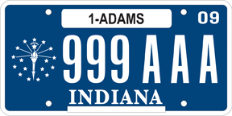






















Where has Key Leader Been?
Nationally
Notes:
We have held Key Leader numerous times in almost every state in the United States. Although there are some East Coast states missing, we have been able to draw many students to surrounding state’s Key Leader events.

Slide 14





Where is Key Leader
Internationally
Brazil
Canada
Grand Cayman
El Salvador
Malaysia
Plus 23 different countries represented at World Camp and Hawaii Teen Experiences
Notes:
Successful events have been run in Brazil, Canada, Grand Cayman island and Malaysia.
We are excited to possibly hold future events in China, El Salvador and Jamaica in 2009.
World Camp began in 2007 and Hawaii Teen Experience began in 2008 - we have had 23 countries represented since that first year.

Slide 15
Expansion
The future of Key Leader:
Introduce and expand program in all North American districts, including Caribbean and Central American countries
Introduce program into Asia and Europe
Notes:
Once the weekend is over, the graduates, as well as adult volunteers should be able to explain what they have learned and accomplished, as well as how they will take what they learned into their community

Slide 16
Weekend Results
Explain what Service Leadership is
Explain personal values
Be a better listener
Indentify personality style
How can you make a difference in your community
Build a personal action plan
Notes:
Once the weekend is over, the graduates, as well as adult volunteers should be able to explain what they have learned and accomplished, as well as how they will take what they learned into their community

Slide 17

What Do Teens Get from Key Leader
How to become…
The best friend
The best leader
The best member of their community
Notes:
Over the course of three days, Teens get a chance to gain knowledge about their community and how they can get involved, tools for building self-confidence and setting goals. At the same time, they have friends and peers to reinforce the messages they learned along the way.

Slide 18
What Teens Say about Key Leader
“Very friendly and energetic atmosphere”
“One of the most amazing weekends of my life”
“Our facilitators were amazing and wonderful”
“It was an awesome camp and an experience I will take with me even after I graduate from high school”
“I learned how to become a good leader through being a good servant”
Notes:
There are numerous reasons why this is amazing, but listed are just a few quotes taken directly from our past participants

Slide 19
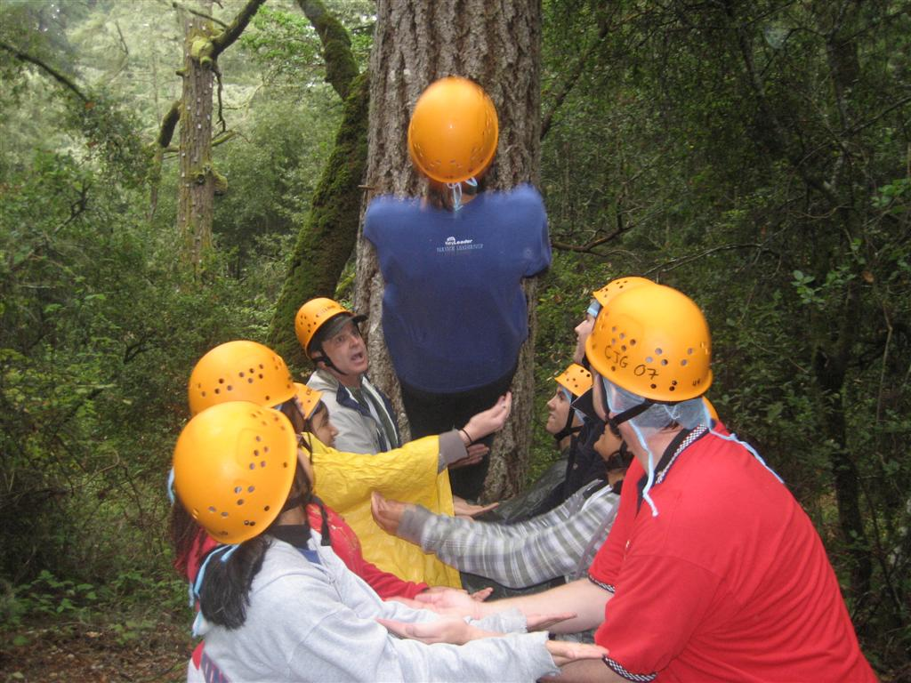
Why Teens Think It’s Amazing
Friends that will last a lifetime
How to face society
Amazing energy
Hands-on activities
Ropes courses
The sense of community
Lifelong skills
Key Leader now a part of their life
Notes:
Although there are many reasons to enjoy the experience, these are a few of the high-lights listed on the evaluations from our participants

Slide 20
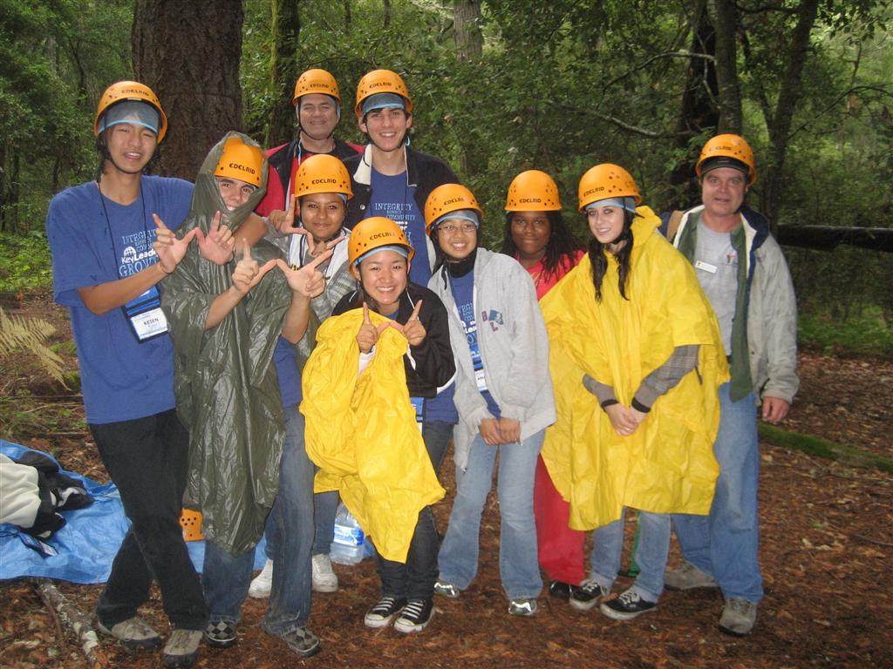

Today’s teens are tomorrow’s leaders. Through Key Leader, you and your club can make a difference in a teen’s life.

Slide 21
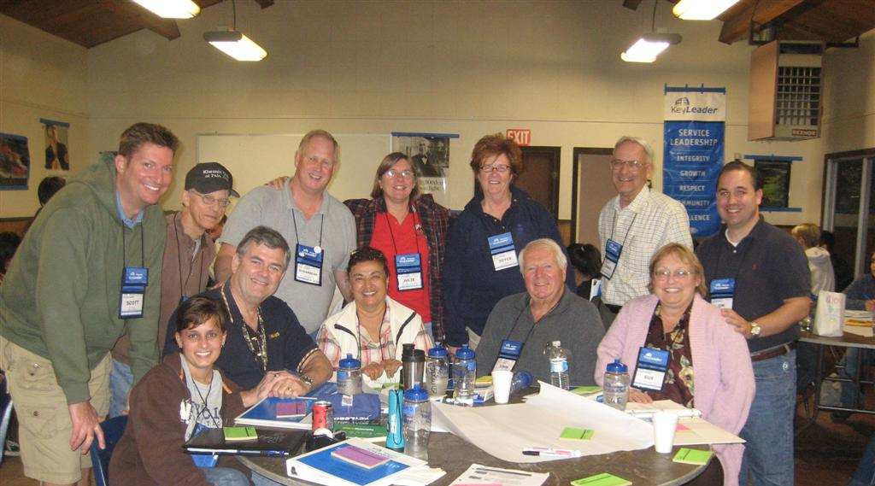
How can Kiwanians Get Involved
Serve the children
Sponsor a student
Plan to lead
Reach out
Join us
Notes:
Serve the Children – Teens are not beyond our Kiwanis focus. Serving the children of the world includes teens, too
Sponsor a Student – Your club can sponsor a student and make a difference in their life. The cost is US$175 for the weekend and clubs have helped sponsor various amounts up to the full cost
Plan to Lead – Plan to sponsor several Key Leader students each year. Be sure to allocate adequate funds in your annual budget
Reach Out – Let people in your community know about Key Leader and the good it’s doing for our teens. Invite others to take part, visit, observe or volunteer at a Key Leader event. You do not have to be a member of a Kiwanis-family program to participate
Join Us – Volunteering at a Key Leader weekend gives you the chance to network with your fellow Kiwanians, get in touch with the younger generation and reinforce your own leadership values

Slide 22
Why Kiwanians Think It’s Amazing
Chance to network with fellow Kiwanians
Make great connections with the younger generation
Potential club growth
Watching Teens “change” during the weekend
Able to make a difference in a teen’s life
Notes:
Ask a Kiwanian why they enjoy the weekend and there will be numerous reasons. Some of the more common answers are listed here

Slide 23
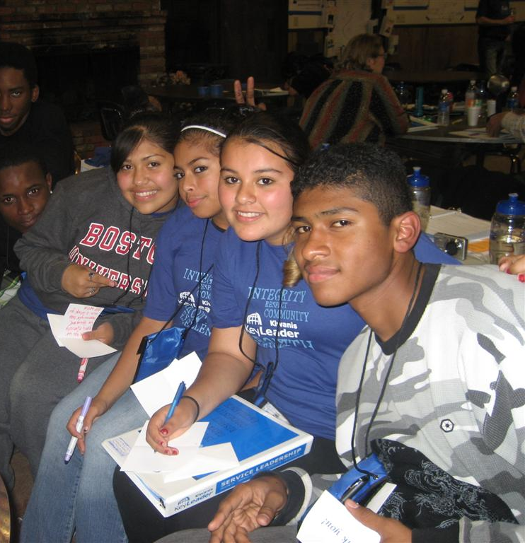
Outreach
Key Leader can reach those not involved with a Kiwanis-family program
Sponsorship by a small club
Community involvement
Notes:
Service Leadership is the core of Kiwanis. Key Leader is open to everyone, which means we can draw individuals not associated with a Kiwanis-family program.
This is a great way for a small club to get involved with today’s youth. If the club cannot dedicate an entire year to a youth organization, they can volunteer and organize a Key Leader weekend. Meet the younger generation, see the changes made over the weekend and know you made a difference.
Sponsoring a Key Leader event can get you out into the community – get to know the school officials – Administration, Principals, teachers. Clubs have been formed from this experience.

Slide 24
End Results – The Key Leader Test
Is what I’m doing helping others to become stronger and more independent?
Do others or does the organization become better because of what I’m doing?
Do my actions help others in my community?
Notes:
We refer to these as the Key Leader Test. If you can answer “yes” to these questions, you are living the life of a great Key Leader

Slide 25
For More Information
Registration Process
Cost
Dates & Locations
Student Facilitator Applications
And More…
www.Key-Leader.org

